Slide 1

C# 7 / c# 8
Kathleen Dollard
.NET Team, Microsoft
@KathleenDollard
kdollard@microsoft.com

Slide 2
C# 7.1 -7.3
async main
Preceding digit separator
Bestest betterness (7.3)
Non-trailing named args
Enum, Delegate unmanaged constraints
Tuple name inference
Tuple equality
Expanding ref goodness (stuff can go faster, Kestrel)
Span and ReadOnlySpan (can even stackalloc)

Slide 3
C# 8: Nullable Reference

Slide 4
C# 8: Pattern matching

Slide 5
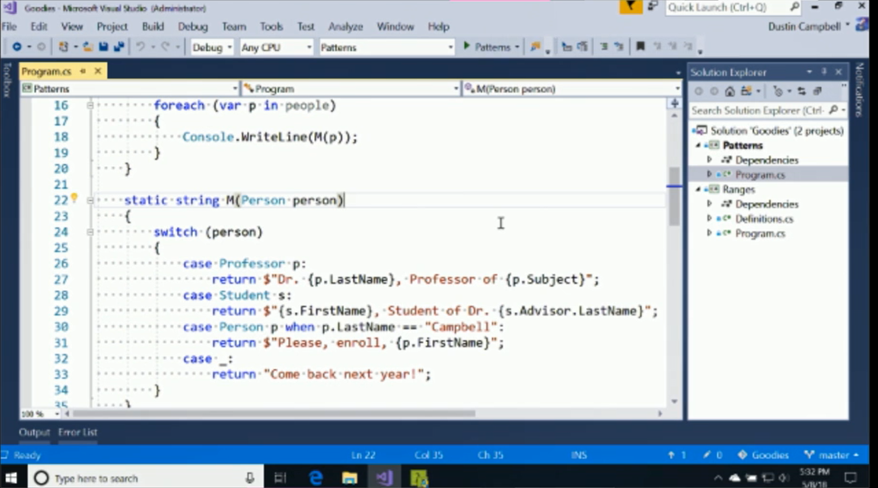

Slide 6
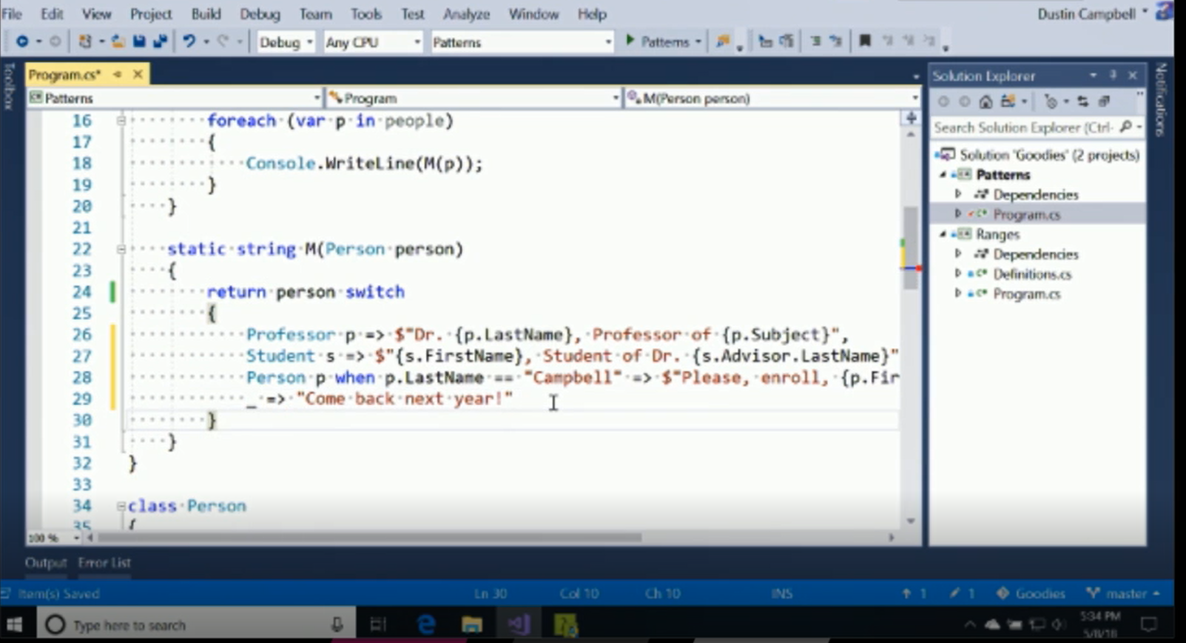

Slide 7
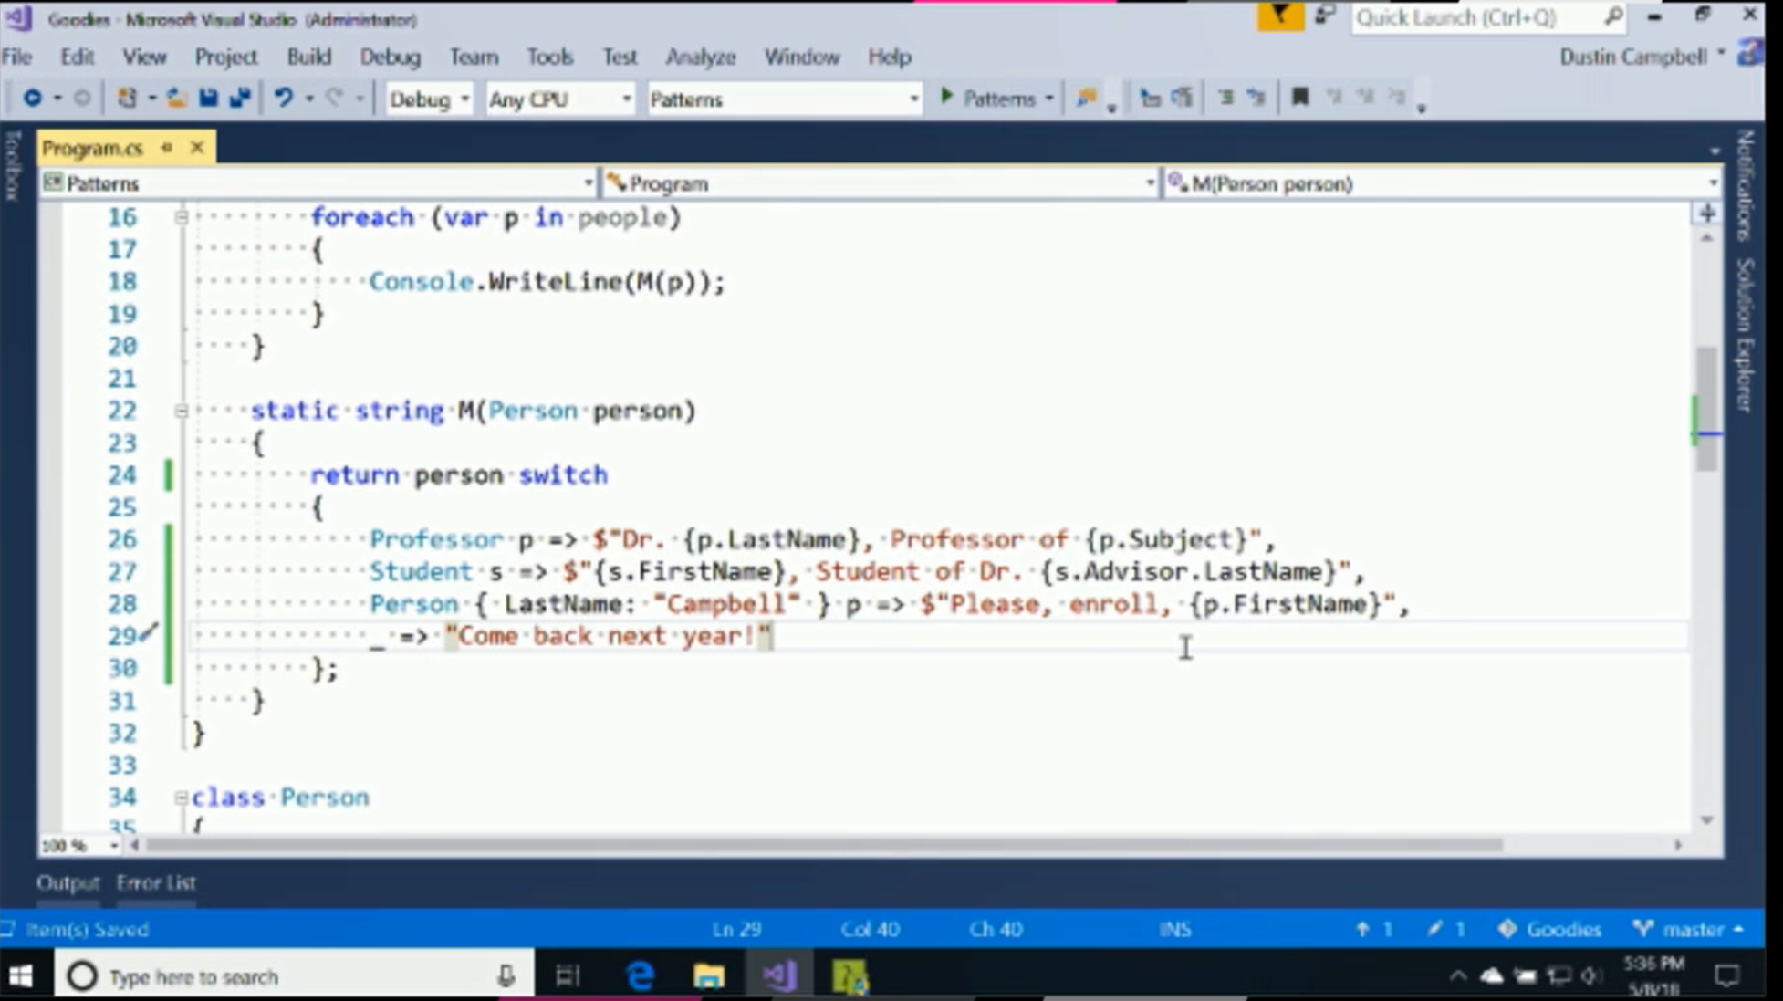

Slide 8
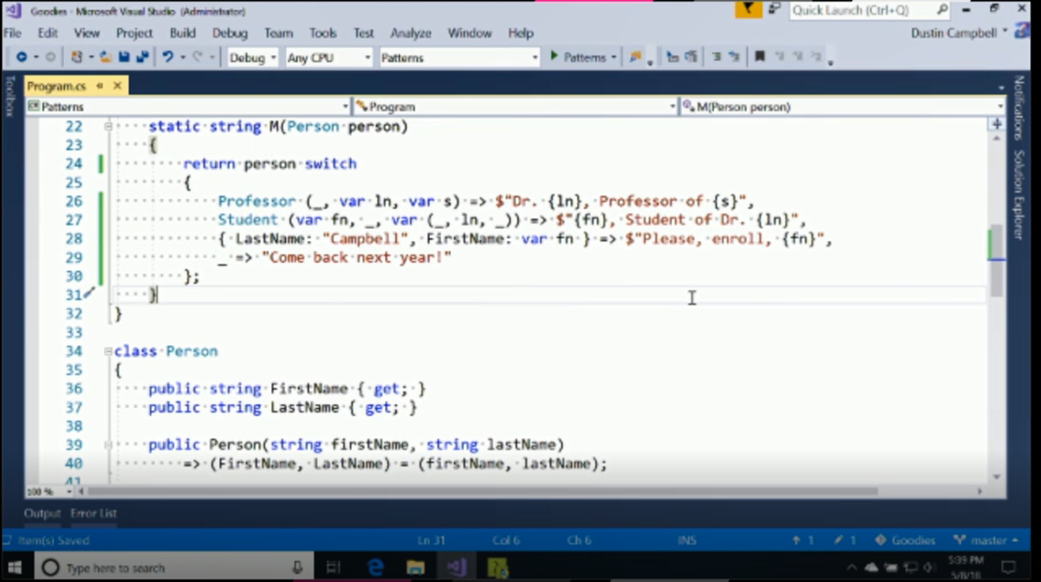

Slide 9
C# 8: System.Index

Slide 10
C# 8: System.Index
Last character:
text[text.Length -1]
text[^1]
Range
text.SubString(1, text.Length – 1)
text[1..^1]
Other
var x = ^(42 + 42);
text[1..]
text[..1]
text[..]

Slide 11
C# 8: New async opportunities
Async Dispose
using await
Async Streams
Start processing while awaiting
No overrunning – retrieval and processing wait on each other

Slide 12
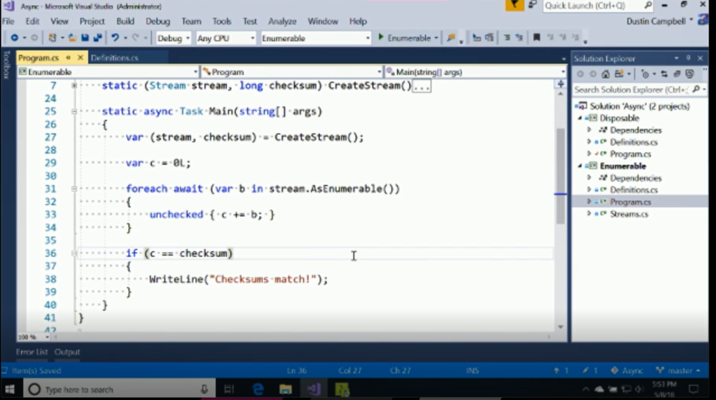

Slide 13
Default Interface Members
interface ILogger
{
void Log(LogLevel level, string message);
}
class ConsoleLogger : ILogger
{
// send message
public void Log(LogLevel level, string message) { }
}

Slide 14
Default Interface Members
interface ILogger
{
void Log(LogLevel level, string message);
void Log(Exception ex) => Log(LogLevel.Error, ex.ToString());
}
class ConsoleLogger : ILogger
{
// send message
public void Log(LogLevel level, string message) { }
}

Slide 15
Default Interface Members
interface ILogger
{
void Log(LogLevel level, string message);
void Log(Exception ex) => Log(LogLevel.Error, ex.ToString());
}
class TelemetryLogger : ILogger
{
// send message
public void Log(LogLevel level, string message) { }
// capture crash dump and send message
public void Log(Exception ex) { }
}

Slide 16
Records
class Person(string First, string Last);
class Person : IEquatable<Person>
{
public string First { get; }
public string Last { get; }
public Person(string First, string Last) => (this.First, this.Last) = (First, Last);
public void Deconstruct(out string First, out string Last) => (First, Last) = (this.First, this.Last);
public bool Equals(Person other) => other != null && First == other.First && Last == other.Last;
public override bool Equals(object obj) => obj is Person other ? Equals(other) : false;
public override int GetHashCode() => GreatHashFunction(First, Last);
…
}

Slide 17
Places to go, things to do…
Get the previews, and send us feedback!
github.com/dotnet/csharplang/wiki
Check the docs:
docs.microsoft.com/en-us/dotnet/csharp/whats-new/

